Slide 1




Flashback: Decoupled Lightweight Wireless Control
Asaf Cidon, Kanthi Nagaraj, Sachin Katti
Pramod Viswanath
University of Illinois at Urbana-Champaign
Stanford University
Notes:
research on cloud and mobile systems
Google Israel
Katti的另一个学生：无线通信
Picasso: Flexible RF and Spectrum Slicing
Decouple 去耦（解耦）：比如数据通道中同时携带控制信息，这两种信息是无干扰的 称为 去耦

Slide 2


How to Schedule a Wireless Network?
File Sync
VoIP
Notes:
基站

Slide 3

Cellular: Decoupled Control Plane
File Sync
Cellular networks pay high price for centralized control
VoIP
Data data data data
Data data data data
I want to transmit VoIP
I want to transmit sync
Data Plane
Data Plane
Control Plane
Control Plane
You go second
You go first
Notes:
同步的过程 协商好
优点：集中控制 优先级 Q0S 信道利用率（无冲突） 无缝切换
缺点：集中控制 高代价：开销大，需要预留一个占很大一部分的带宽；OFDMA微秒级的同步技术，依赖基站精准的时钟同步。

Slide 4

Wi-Fi: Implicit Control
Is anyone transmitting?
Yes. I must back off.
1 Mississippi,
2 Mississippi…
Is anyone transmitting?
No. Let’s go!
VoIP
File Sync
Data data data data
Data data data data
Data Plane
Data Plane
Hidden Node
Collision
Data data data data
Notes:
implicit隐式控制CSMA
Explicit显式控制RTS/CTS
优点：简单，即插即用
缺点：低效 碰撞
这里要讲解一下隐藏终端 带来碰撞 为了解决这个问题 提出了 RTS：请求发送

Slide 5
The Challenge: the Best of Both Worlds
Can we get the benefits of centralized control?
While retaining Wi-Fi’s asynchronous and distributed properties
Without designating spectrum
I want to transmit
Data data data data

Slide 6
Flashback
Flashback is a decoupled, lightweight control plane
Decoupled: send control messages concurrently with data messages on the same channel
Lightweight: barely impacts network performance (<1% packet loss)
Control Plane: enables rich set of applications (efficient scheduling, QoS enforcement, power savings, fast association, etc.)

Slide 7
How can we send control messages without interfering with data packets?
Data data data data
Flash

Slide 8

OFDM is a Grid
63
Symbol | Symbol | Symbol | Symbol
Symbol | Symbol | Symbol | Symbol
Symbol | Symbol | Symbol | Symbol
Symbol | Symbol | Symbol | Symbol
Symbol | Symbol | Symbol | Symbol
Symbol | Symbol | Symbol | Symbol
Symbol | Symbol | Symbol | Symbol
Symbol | Symbol | Symbol | Symbol
62
61
60
20 MHz
…
…
…
Subcarrier Position
3
2
1
0
0
4
8
12
16
Time [$μs$]
Notes:
OFDM即正交频分复用技术
将信道分成若干正交子信道，将高速数据信号转换成并行的低速子数据流，调制到在每个子信道上进行传输

Slide 9
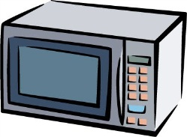
Redundancy Protects from Errors
Wi-Fi Packet
Symbol | Symbol | Symbol | Symbol
Symbol | Symbol | Symbol | Symbol
Symbol | Symbol | Symbol | Symbol
Symbol | Symbol | Symbol | Symbol
Symbol | Symbol | Symbol | Symbol
Symbol | Symbol | Symbol | Symbol
Symbol | Symbol | Symbol | Symbol
Symbol | Symbol | Symbol | Symbol
Symbol | Symbol | Symbol | Symbol
Symbol | Symbol | Symbol | Symbol
Symbol | Error | Symbol | Symbol
Error | Error | Symbol | Symbol
Symbol | Symbol | Symbol | Symbol
Symbol | Symbol | Symbol | Symbol
Symbol | Symbol | Symbol | Symbol
Symbol | Symbol | Symbol | Error
Symbol | Symbol | Symbol | Error
Symbol | Symbol | Symbol | Error
Symbol | Symbol | Symbol | Error
Symbol | Symbol | Symbol | Symbol
Symbol | Symbol
Symbol | Symbol
Symbol | Symbol
Symbol | Symbol
Symbol | Symbol
Symbol | Symbol
Symbol | Symbol
Symbol | Symbol
Symbol | Symbol
Symbol | Symbol

Slide 10
Rate Adaptation Adds Redundancy
Rate adaptation trades off redundancy and throughput
Redundancy is added in significant discrete chunks
Dropping a packet is very costly
Rate adaptation errs on the conservative side
Notes:
编码率越高 比特率越高 SNR越大 鲁棒性越差

Slide 11
Notes:
SNR 信噪比即放大器的输出信号的电压与同时输出的噪声电压的比 设备的信噪比越高表明它产生的杂音越少。
Link Margin 链路容限
是SNR的真实测量值与理论值的一个差值。
产生的原因：
SNR 毫秒级的 变动 很难测量，因此如果要计算发送的速率也是会有误差，所以实际发送过程中会以低于理论值的比特率发送。这样便会产生link margin。

Slide 12
Exploiting Margin
Key insight: intentionally interfere
Leverage OFDM grid structure
Localize interference in the OFDM grid
Flashes: high powered single subcarrier signal
Single frequency sinusoid on particular time slot
Symbol | Symbol | Symbol | Symbol
Symbol | Symbol | Flash | Symbol
Symbol | Symbol | Symbol | Symbol
Symbol | Symbol | Symbol | Symbol
Flash | Symbol | Symbol | Symbol
Symbol | Symbol | Symbol | Symbol
Notes:
Instead of sending a regular OFDM packets over the entire band, the control message transmit-ter sendsflashes. （不是整个频段） 把影响降低到某个局部 而不是整个频段

Slide 13
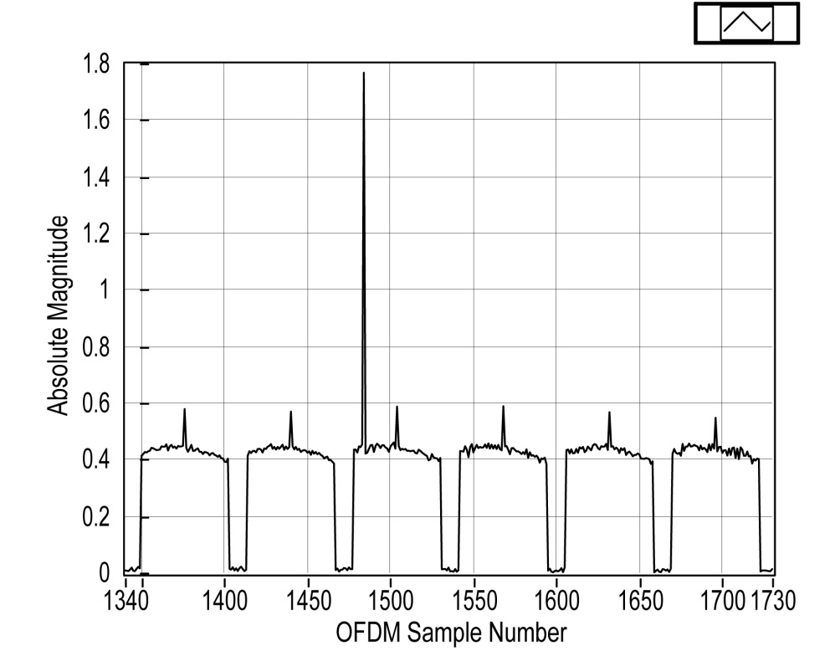
Receiver Detects Flashes in Parallel
Flashes are easy to detect at receiver
Power spike on single subcarrier
Erase flashes from data packet
Decode flash and data packet in parallel
Flash
Notes:
由于时钟不是同步的，因此接收端有可能接收到的 峰值 是跨在两个时间段上。

Slide 14

How is the Control Message Encoded?
Messages encoded by relative distance between consecutive flashes
Each digit is relative distance
Digit 1: 60 – 3 = 57
Digit 2: 62 - 60 = 2
63
Symbol | Symbol | Symbol | Symbol
Symbol | Symbol | Flash | Symbol
Symbol | Symbol | Symbol | Symbol
Symbol | Flash | Symbol | Symbol
Flash | Symbol | Symbol | Symbol
Symbol | Symbol | Symbol | Symbol
Symbol | Symbol | Symbol | Symbol
Symbol | Symbol | Symbol | Symbol
62
61
60
…
…
…
Subcarrier
3
2
1
0
0
4
8
12
16
Time [$μs$]

Slide 15
Practical Concerns
Flash transmitter is not synchronized to receiver
CFO problem solved using relative frequencies
Time sync problem solved by detecting flashes at whole and half samples
AGC
Commodity ADCs have sufficient dynamic range to accommodate both data and flashes
Notes:
CFO carrier frequency offset 载波频率便宜

Slide 16
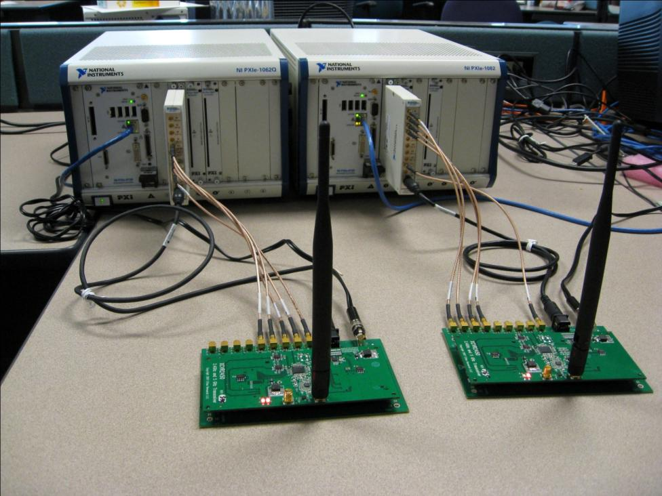
Implementation
Implemented OFDM PHY supporting Flashback
Receiver + transmitter
Implementation using NI Virtex-5 LX30 FPGA based software radios
Designed with LabVIEW

Slide 17
Transmitter Implementation
Data Packet
Encoder
MUX
Modulator
Control Message
Flash Encoder
64 IFFT
Cyclic Prefix
DAC

Slide 18
Receiver Implementation
Modular, requires minimal changes
ADC
Sync
64 FFT
Equalizer
Demodul-ator
Flash Detector
Flash Eraser
Viterbi Decoder
Flash Decoder
Control Message
Data Packet

Slide 19
Maximum Flash and Data Rate
50,000 flashes per second
175 kb/sec
125,00 flashes per second
400 kb/sec

Slide 20
Flashback-MAC
Node 5
Node 1
Flash
Data Data Data Data
Data Data Data Data
Flash
Demand Map
Node 5 | 150 KB | Bulk Transfer
Node 1 | 20 KB | Low Latency
Demand Map
Node 5 | 150 KB | Bulk Transfer
ACK + piggyback

Slide 21
Centralized scheduling → 4X throughput
Notes:
RTS/CTS协议，即请求发送，允许发送协议。相当于一种握手协议。主要用来解决隐藏终端的问题。
隐藏终端：基站A向基站B发送信息，基站C未侦测A也向B发送，所以A和C同时将信号发送到B，引起信号冲突。
A向B发送RTS信号，表明A要向B发送若干数据，B收到RTS后向所有基站发送CTS信号，表明已经准备就绪，其余基站 按兵不
动 然后A 向 B发送数据。最后 B 接收完数据后向所有基站广播 ACK确认帧。
RTS/CTS的缺点：发送这类控制包需要一个可靠的方式，即低比特率发送，于是占用了信道时间；另外在拥塞的网络 Qos 也不能很好的保证，因为这些控制信息是包含在数据通道上。于是很多管理员都不启用这个协议

Slide 22
Decoupled Control = High Utilization

Slide 23
Flashback enforces QoS in extreme scenarios

Slide 24
Broader Implications of Flashback
Decoupling is key property of Flashback
Enables hitherto impossible applications
Power duty cycling
Fast association
Coexistence across networks
Peer discovery
…

Slide 25
Summary
What: Flashback is a decoupled lightweight control plane
How: Cause localized interference to send control messages
Why: Centralized scheduling facilitates many applications

